Slide 1



PrestoDirect – Supplier Portal Guideline

Slide 2


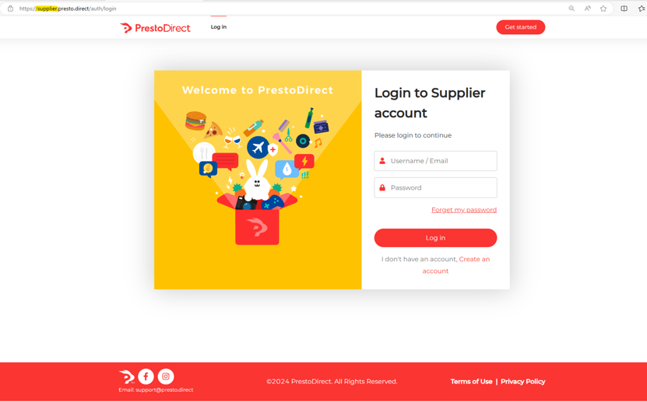
Supplier
Guideline
Login Supplier account via URL : https://supplier.presto.direct/auth/login
Private & Confidential. All Rights Reserved © Presto

Slide 3
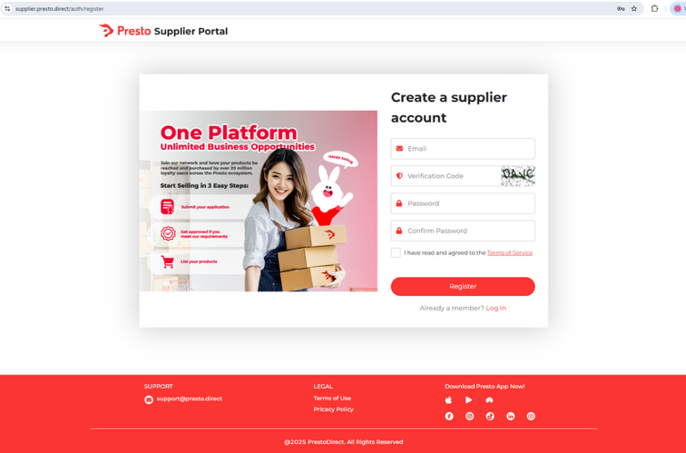
Supplier
Guideline
2. Click on Create account
i. Email address : after register and cannot be amend in future
ii. Password : Alphanumeric with 8 character minimum.
iii. Require to click on agree to Term & condition.
iv. Click on Register button
Private & Confidential. All Rights Reserved © Presto

Slide 4
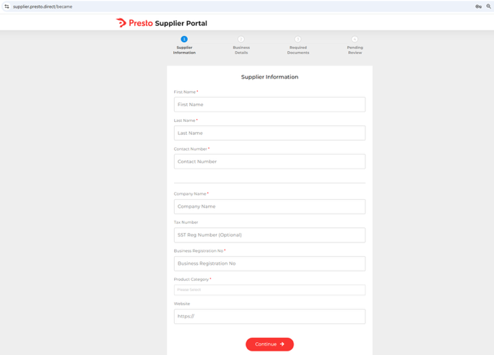
Supplier
Guideline
3. Supplier information. Please fill up person in charge detail and Company detail.
4. Select the Product Categories which you want to sell
5. Input website link if you have any.
Private & Confidential. All Rights Reserved © Presto

Slide 5
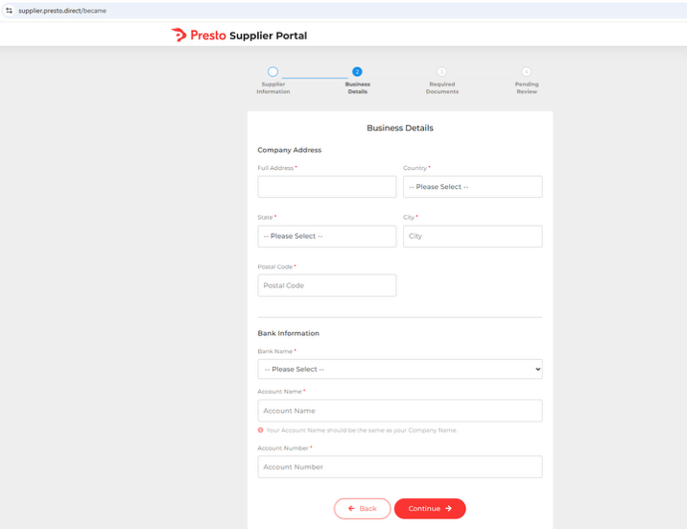
Supplier
Guideline
6. Fill up the company register address and bank detail for settlement purpose
Private & Confidential. All Rights Reserved © Presto

Slide 6
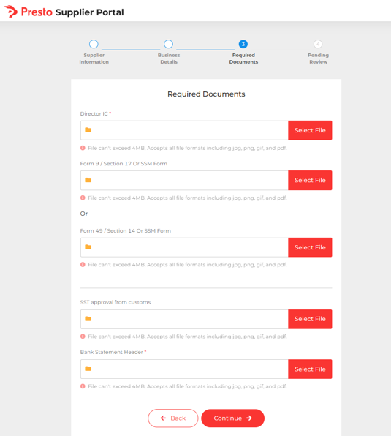
Supplier
Guideline
7. Please upload document which highlighted in Green.
8. Bank Statement : We only accept the physical copy with Bank letter header.
9. Click on Continue Button
Private & Confidential. All Rights Reserved © Presto

Slide 7
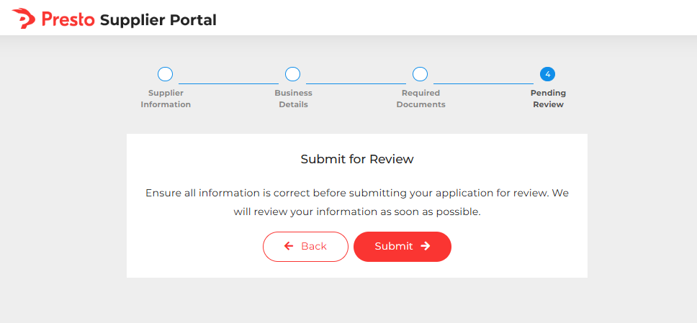
Supplier
Guideline
10. Click on submit button, Presto will review the document and approve once document is sufficient
Private & Confidential. All Rights Reserved © Presto

Slide 8
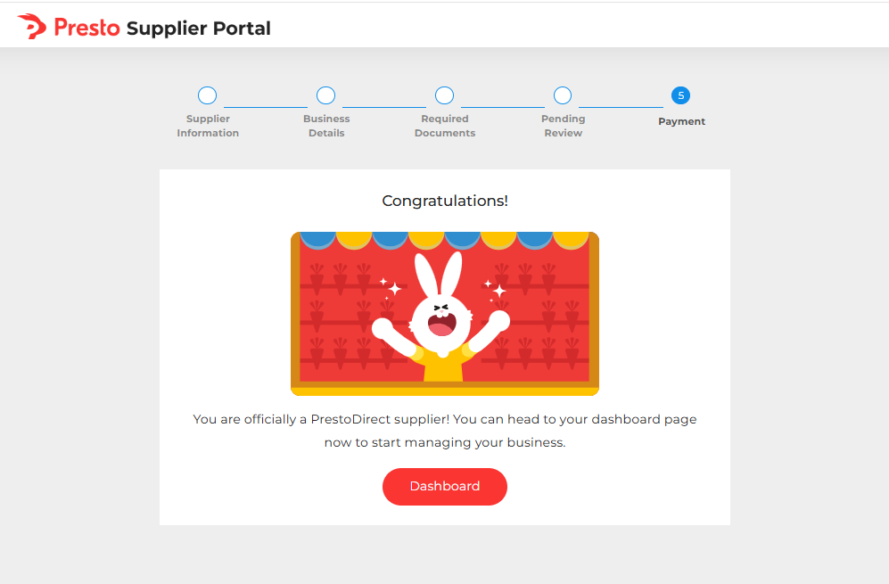
Supplier
Guideline
11. Click on dashboard button once the account has approved
The access is allowed multiuser to access concurrently
Private & Confidential. All Rights Reserved © Presto

Slide 9
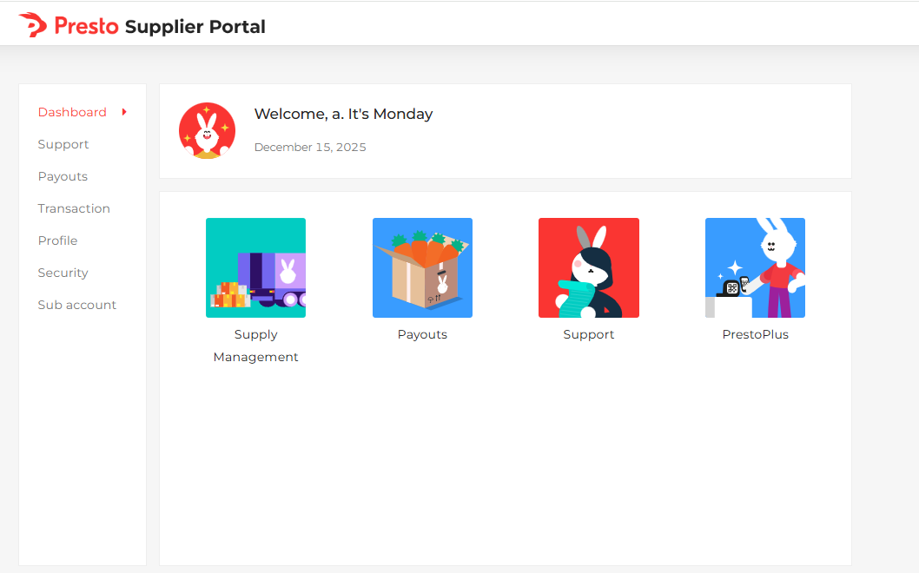
Supplier
Guideline
12. Click on Continue button
View Supplier account Profile
Change Login account Password
Sales Order and Product Listing Management
Contact Presto CS for support
Private & Confidential. All Rights Reserved © Presto

Slide 10
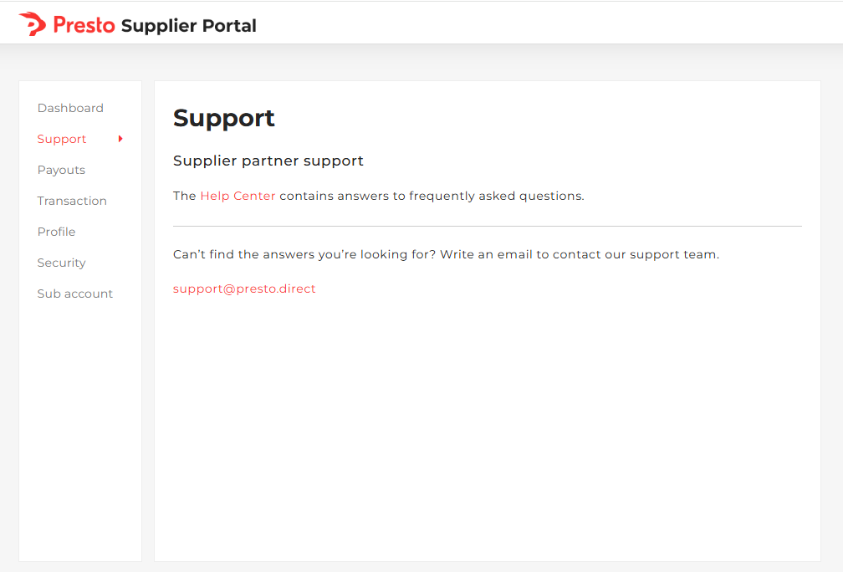
Supplier
Support
Private & Confidential. All Rights Reserved © Presto

Slide 11
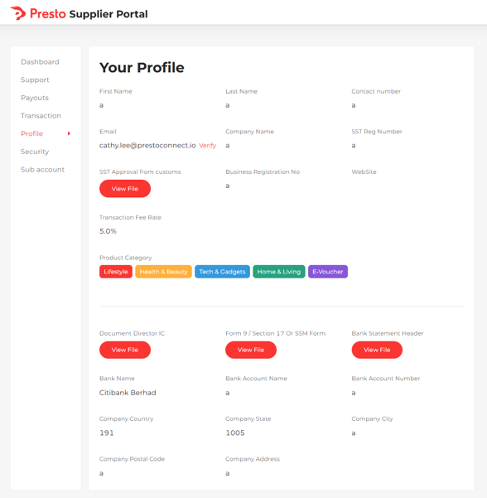
Supplier
Profile
Private & Confidential. All Rights Reserved © Presto

Slide 12
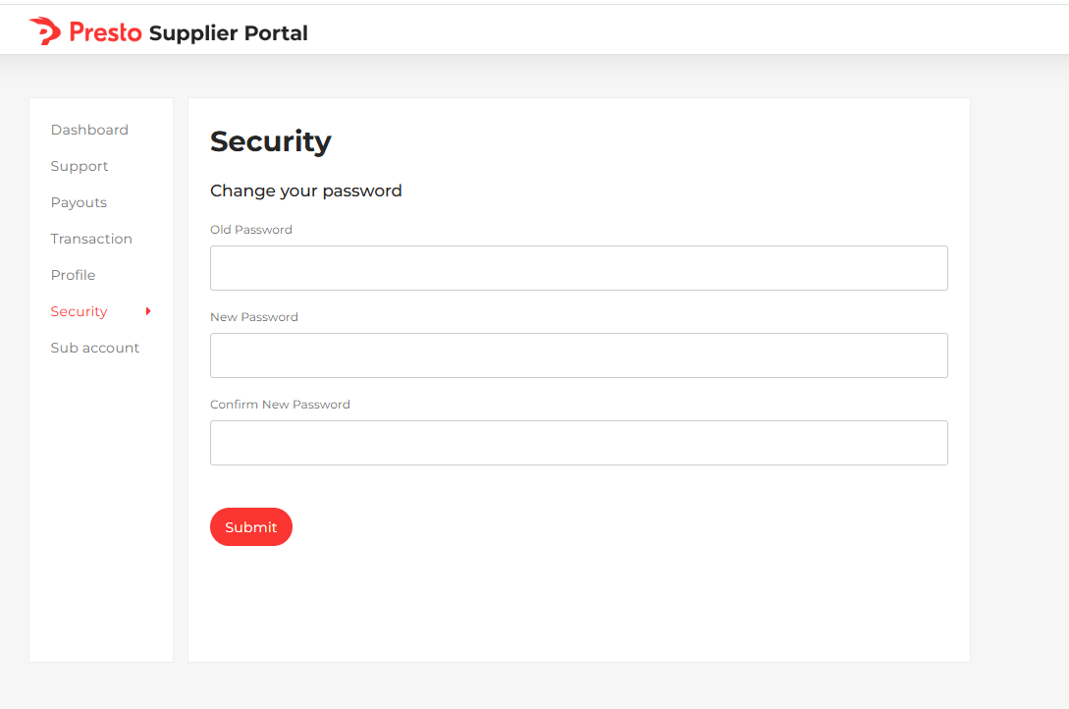
Supplier
Security
Private & Confidential. All Rights Reserved © Presto

Slide 13
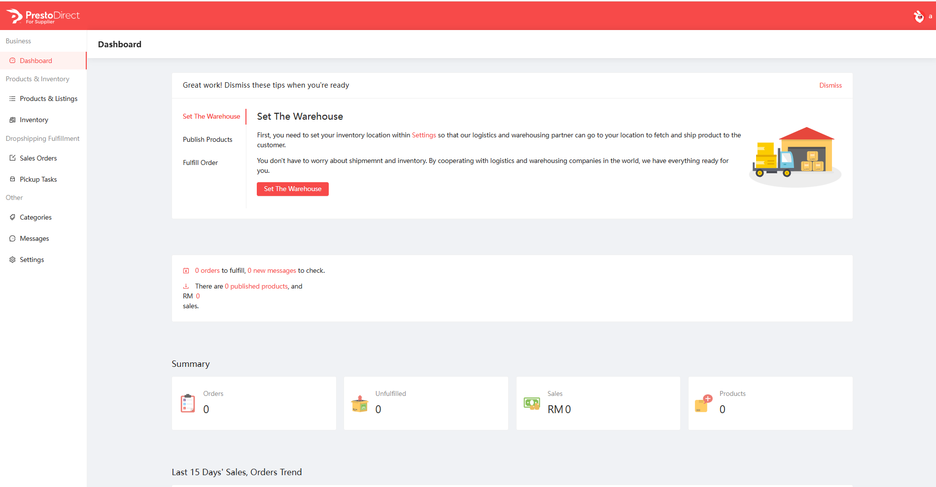
Supplier
Supply Management
Private & Confidential. All Rights Reserved © Presto

Slide 14
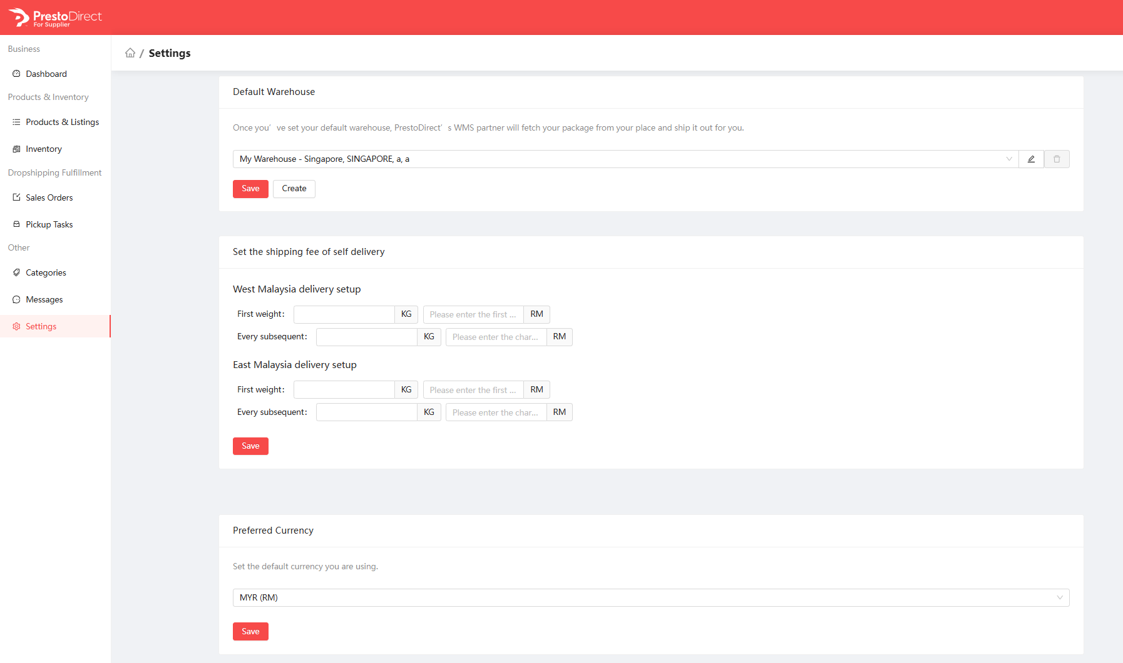
Supplier
Settings
Please setup the warehouse for shipping fee calculation purpose and it allow to setup multiple warehouse.
Do click on save button to capture the settings
Buyer will pay the shipping fee according this setting here.
Do click on save button to capture the settings
Private & Confidential. All Rights Reserved © Presto

Slide 15
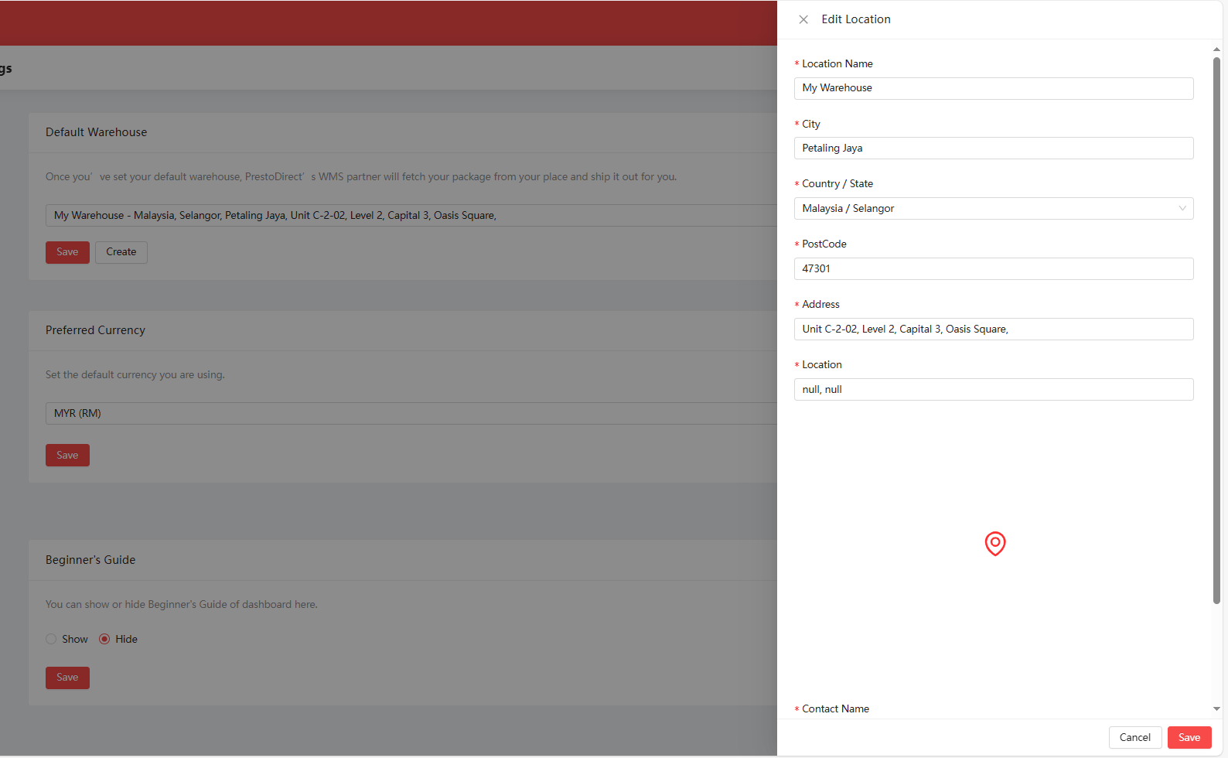
Supplier
Setup Warehouse Address
Fill up the information and click save
Private & Confidential. All Rights Reserved © Presto

Slide 16
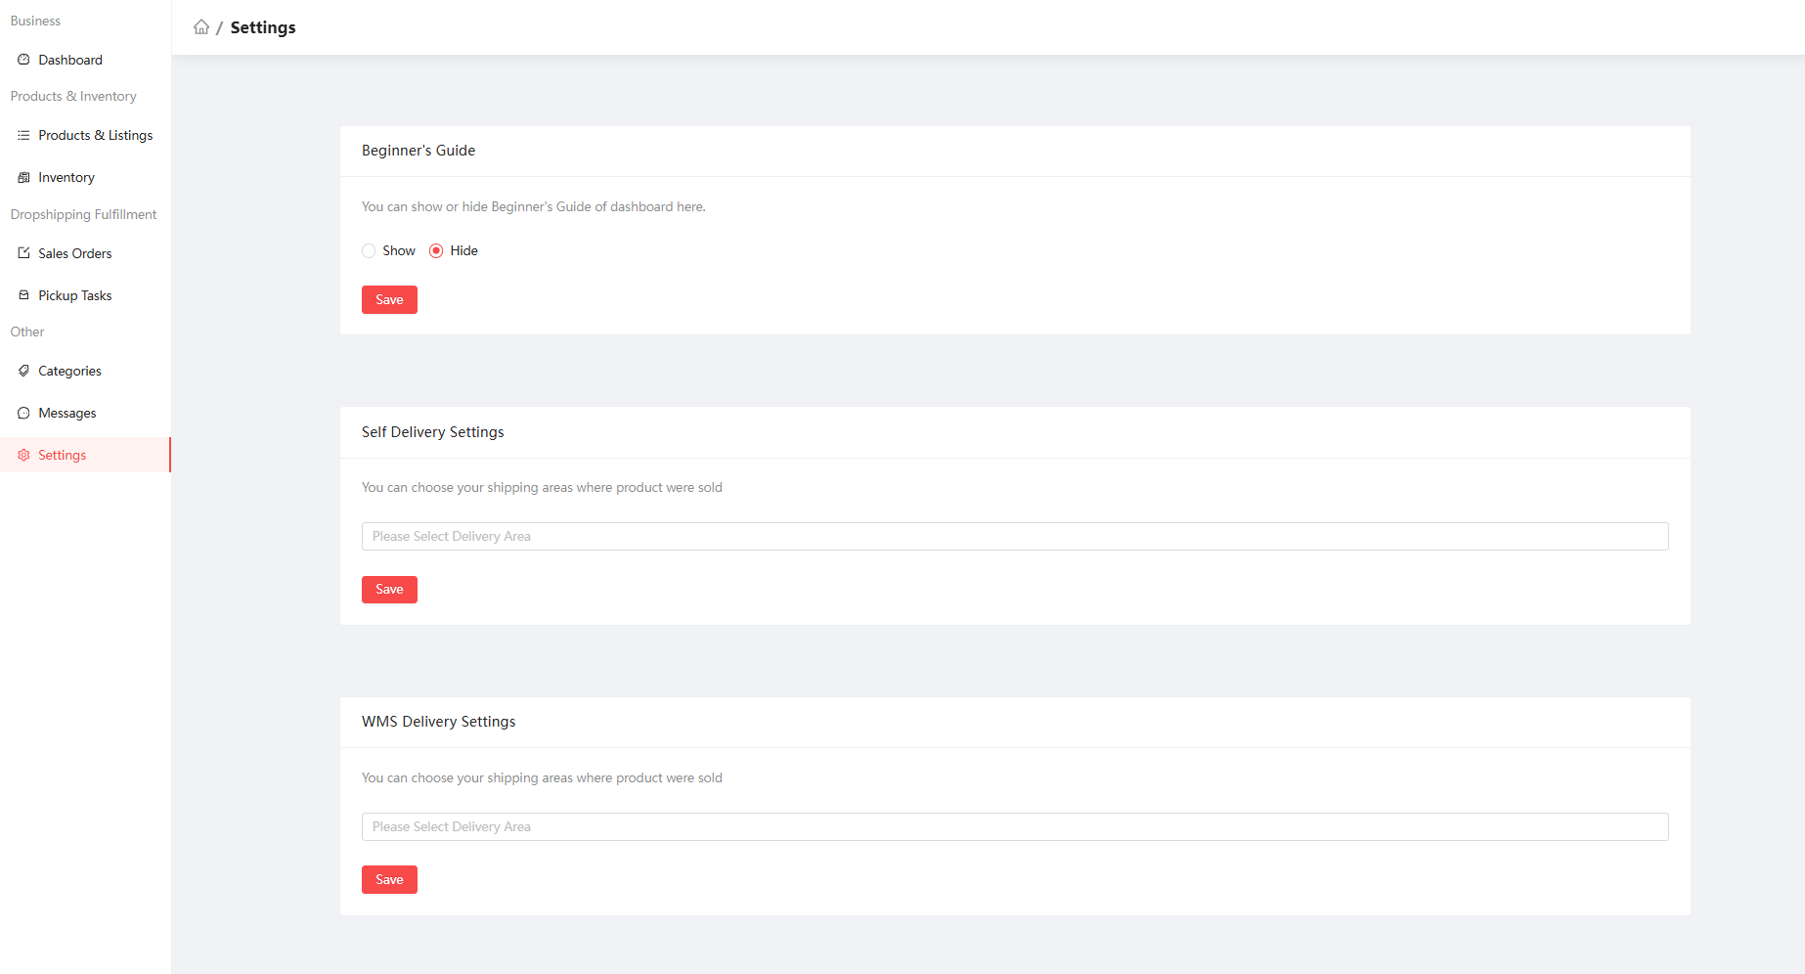
Supplier
Settings
Please do select which are the shipping area that you are cover and click on the save button.
Private & Confidential. All Rights Reserved © Presto

Slide 17
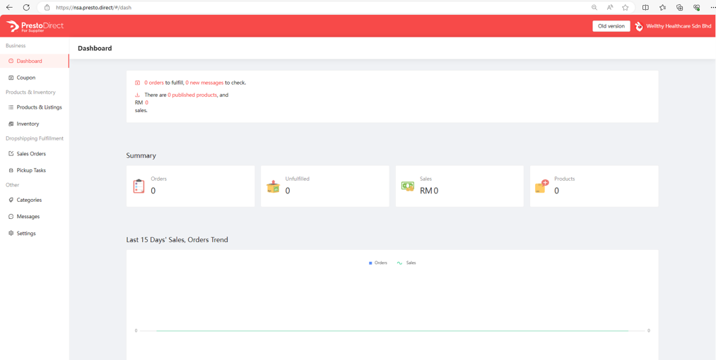
Supplier
Product Listing
1. Click on Product & Listings
Private & Confidential. All Rights Reserved © Presto

Slide 18
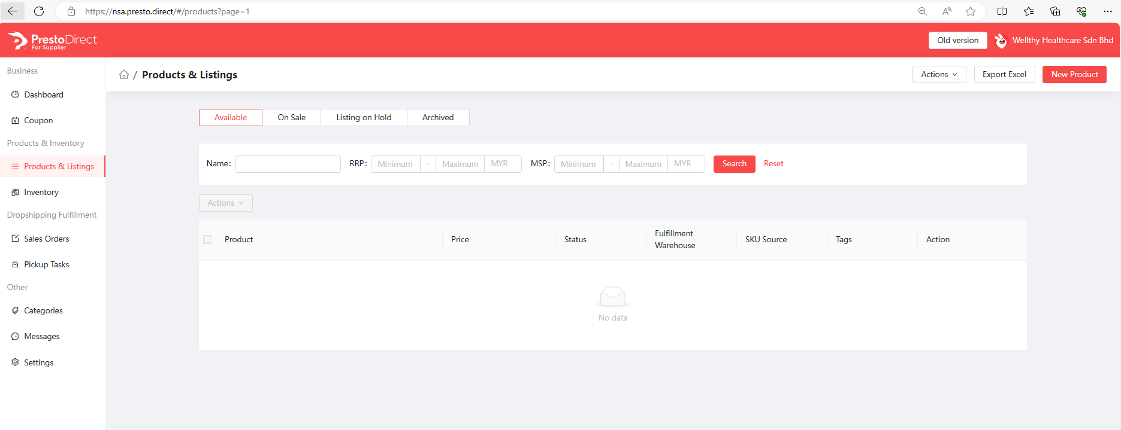
Supplier
Product Listing
2. Click on New Product
Private & Confidential. All Rights Reserved © Presto

Slide 19
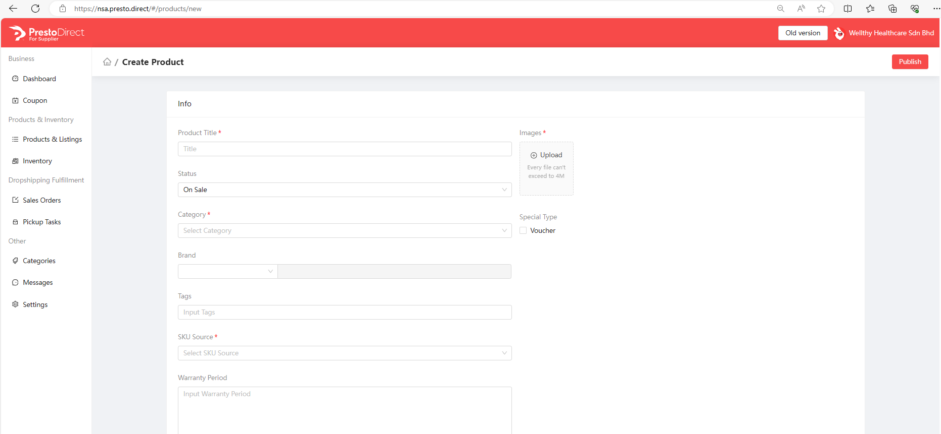
Supplier
Product Listing
3. Fill up the product information
Product Name format :
Within 60 characters
No Full capital letter
Start with Brand Name + Product Name + Model Number
Status :
On Sale – ready to sale and allow retailer account to source the SKU
Listing On Hold – SKU is not available to sale in Retailer
Archive – SKU is not longer selling and delete from system
Image Requirement :
File type with jpeg, jpg, PNG
File size : less than 1MB each file
1000 x 1000 px size
White background for main image
E-voucher Listing only and do not convert to physical product after the SKU has created into system
Select the product category
Please select SKU Source under Back-to-Back (S)
Private & Confidential. All Rights Reserved © Presto

Slide 20
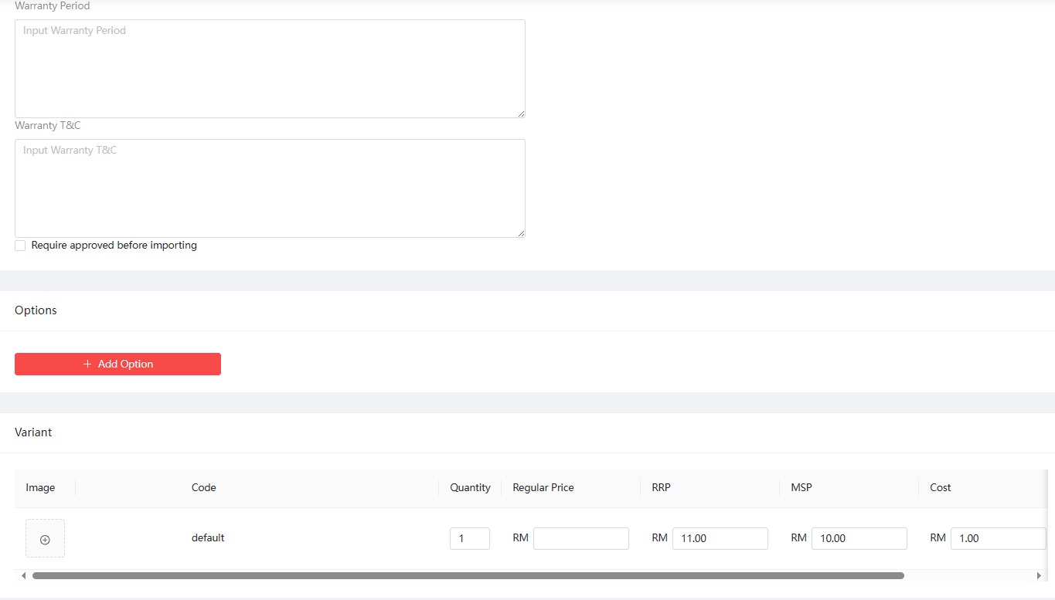
Supplier
Product Listing
Template 1 :
7 Days Exchange & Return Policy
Coverage: This policy covers manufacturing defects only.
Duration: The exchange and return period is valid for 7 calendar days from the delivered date.
Claim Process:
1. To initiate a claim, please contact Presto Care.
2. Ensure to provide an unboxing video as proof of the defect.
3. Items must be returned in their original packaging.
Private & Confidential. All Rights Reserved © Presto

Slide 21
Supplier
Product Listing
Template 2 :
Coverage Period: 12-months warranty coverage for manufacturing defects.
Claim Process: Please contact Presto Care with unboxing video and return with original packaging.
Click here if you need variant setting for this SKU
Private & Confidential. All Rights Reserved © Presto

Slide 22
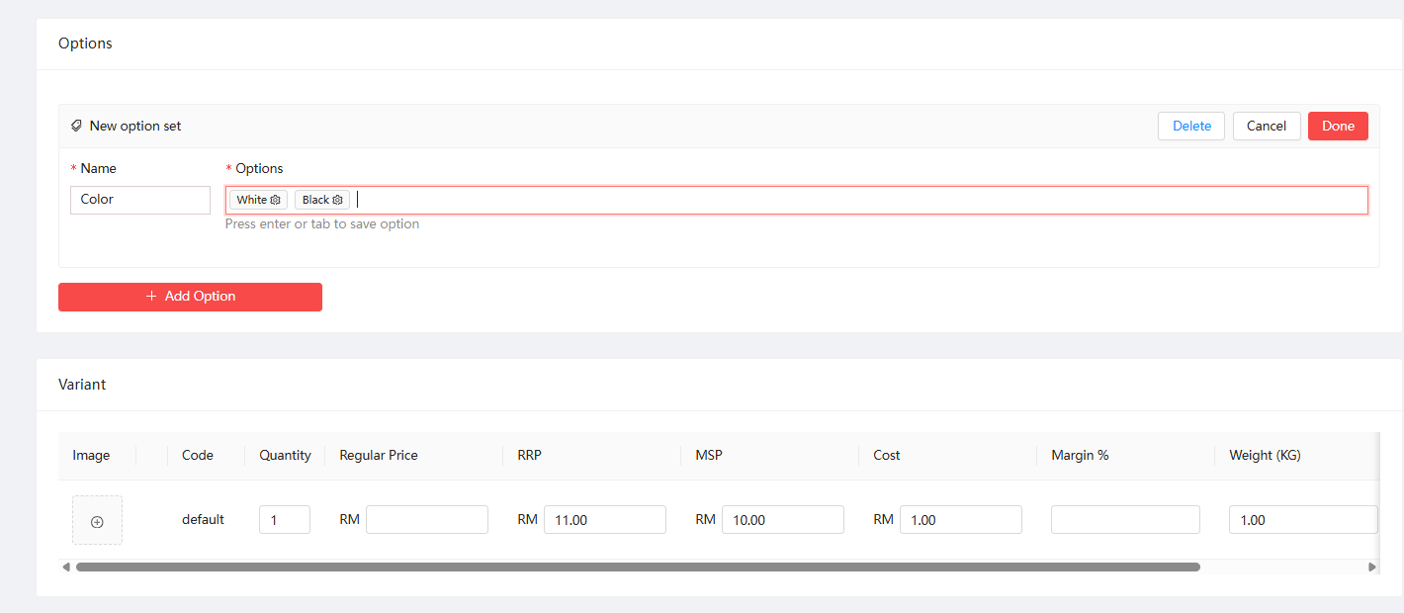
Supplier
Product Listing
Click Done after you have complete the variant option
Private & Confidential. All Rights Reserved © Presto

Slide 23
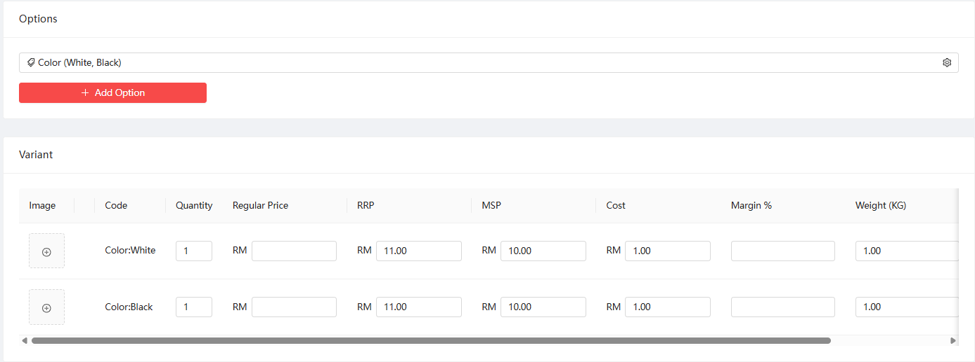
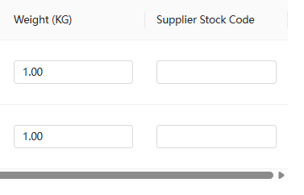
Supplier
Product Listing
Regular Price : Original Price which display for buyer to see, and system will have the Slash features if the RRP is much cheaper than Regular Price.
RRP : Price that want buyer to make purchase on.
MSP : Minimum Supplier prices. Please input 1 cent lower than RRP.
Cost : Put RM1.00
Supplier Stock Code : Supplier self SKU Code reference.
Min Quantity is 10
Weight (KG) : pls input packaging weight or volumetric weight whichever heavy. The system will calculate shipping fee based on this column
Private & Confidential. All Rights Reserved © Presto

Slide 24
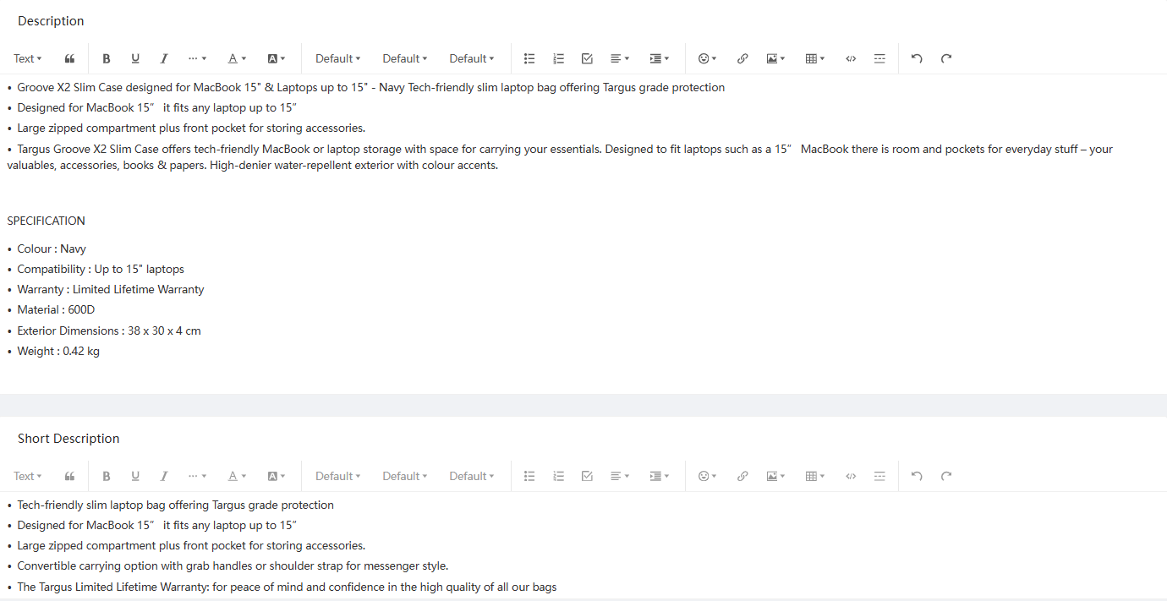
Supplier
Product Listing
Description :
is refer the SKU info in full spec and require information.
Format should be follow by bullet format as below sample
Short Description :
Format should be follow by point format as below sample.
Short highlight of the SKU or features and minimum 3 features.
Private & Confidential. All Rights Reserved © Presto

Slide 25
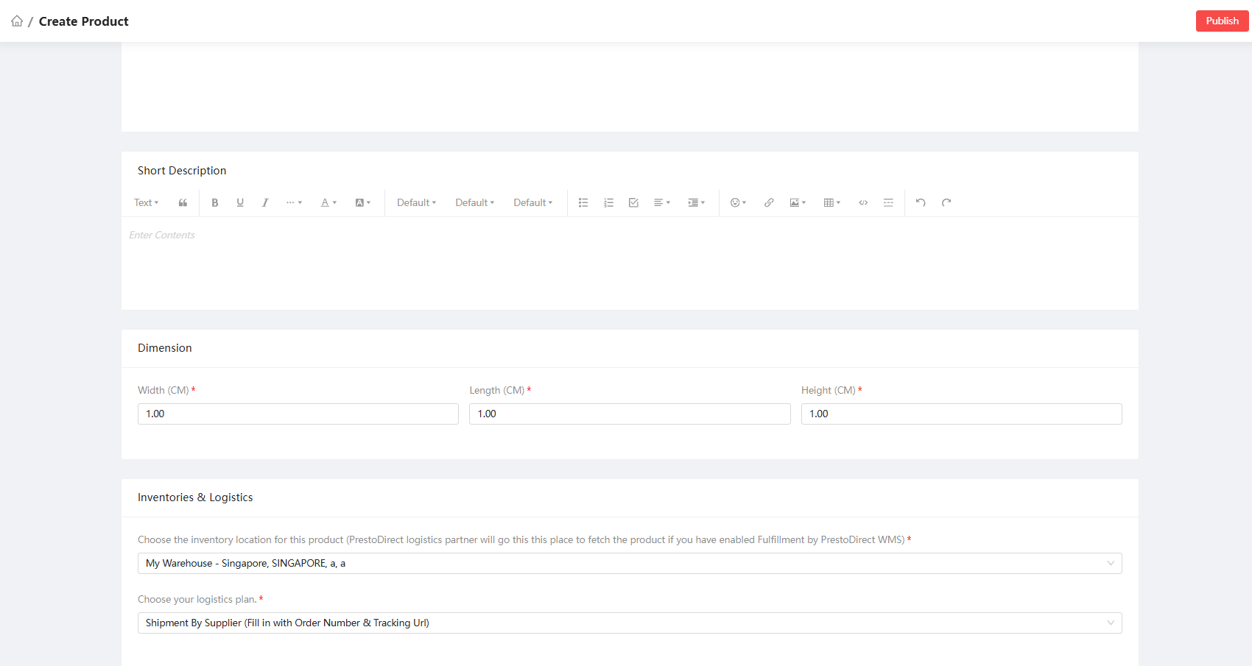
Supplier
Product Listing
Click Publish button once the listing complete.
Packaging Dimension
Select the warehouse that you want to pick and pack from
Select this as the logistics plan
Private & Confidential. All Rights Reserved © Presto

Slide 26
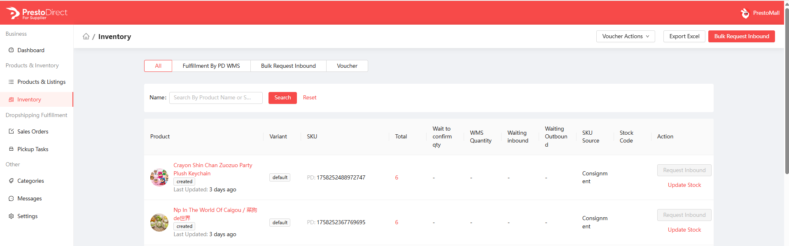
Retailer
SKU Number
After new SKU has publish, SKU number can search under Inventory Page. The SKU number copy and paste into Excel cell format under Text format when proposing SKU to Presto.
Total : is referring the selling quantity in platform.
Update Stock : you can update the stock quantity for selling purpose and system will reflected within 10 min.
Private & Confidential. All Rights Reserved © Presto

Slide 27
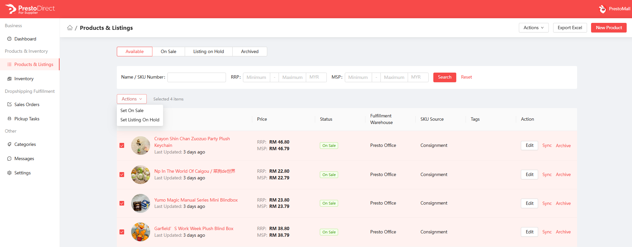
Supplier
Bulk SKU on sale / Listing On Hold
Under Product & Listing page : Select the SKU and click on Action Button and the system will auto update the SKU status according the requirement.
Private & Confidential. All Rights Reserved © Presto

Slide 28
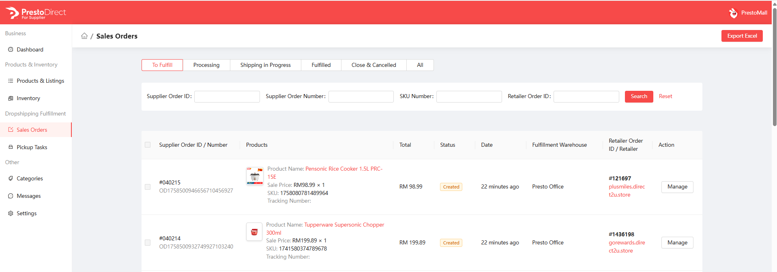
Supplier
Order Fulfilment Progress
Order SKU info and Quantity
Order ID & The order is from which Channel
Click on the manage button to manage the order
Private & Confidential. All Rights Reserved © Presto

Slide 29
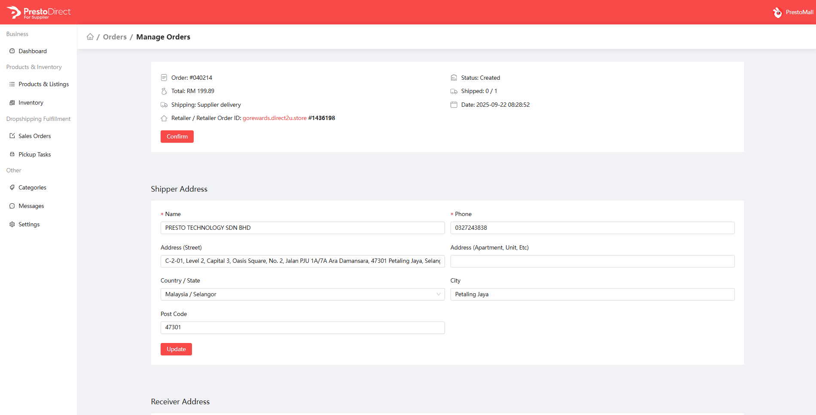
Supplier
Order Fulfilment Progress
Order Acceptance Date and Time
Order ID & The order is from which Channel
Private & Confidential. All Rights Reserved © Presto

Slide 30
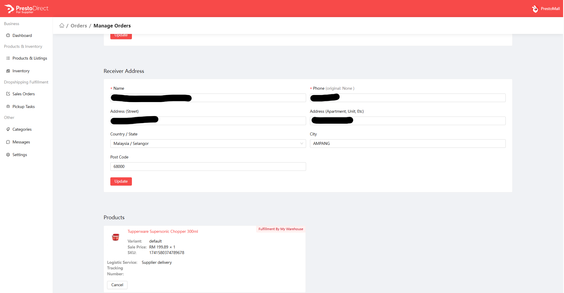
Supplier
Order Fulfilment Progress
Buyer information
Purchase SKU order information
Private & Confidential. All Rights Reserved © Presto

Slide 31
Supplier
Order Fulfilment Progress
Click on confirm button after review the order information to process the order fulfilment
Private & Confidential. All Rights Reserved © Presto

Slide 32
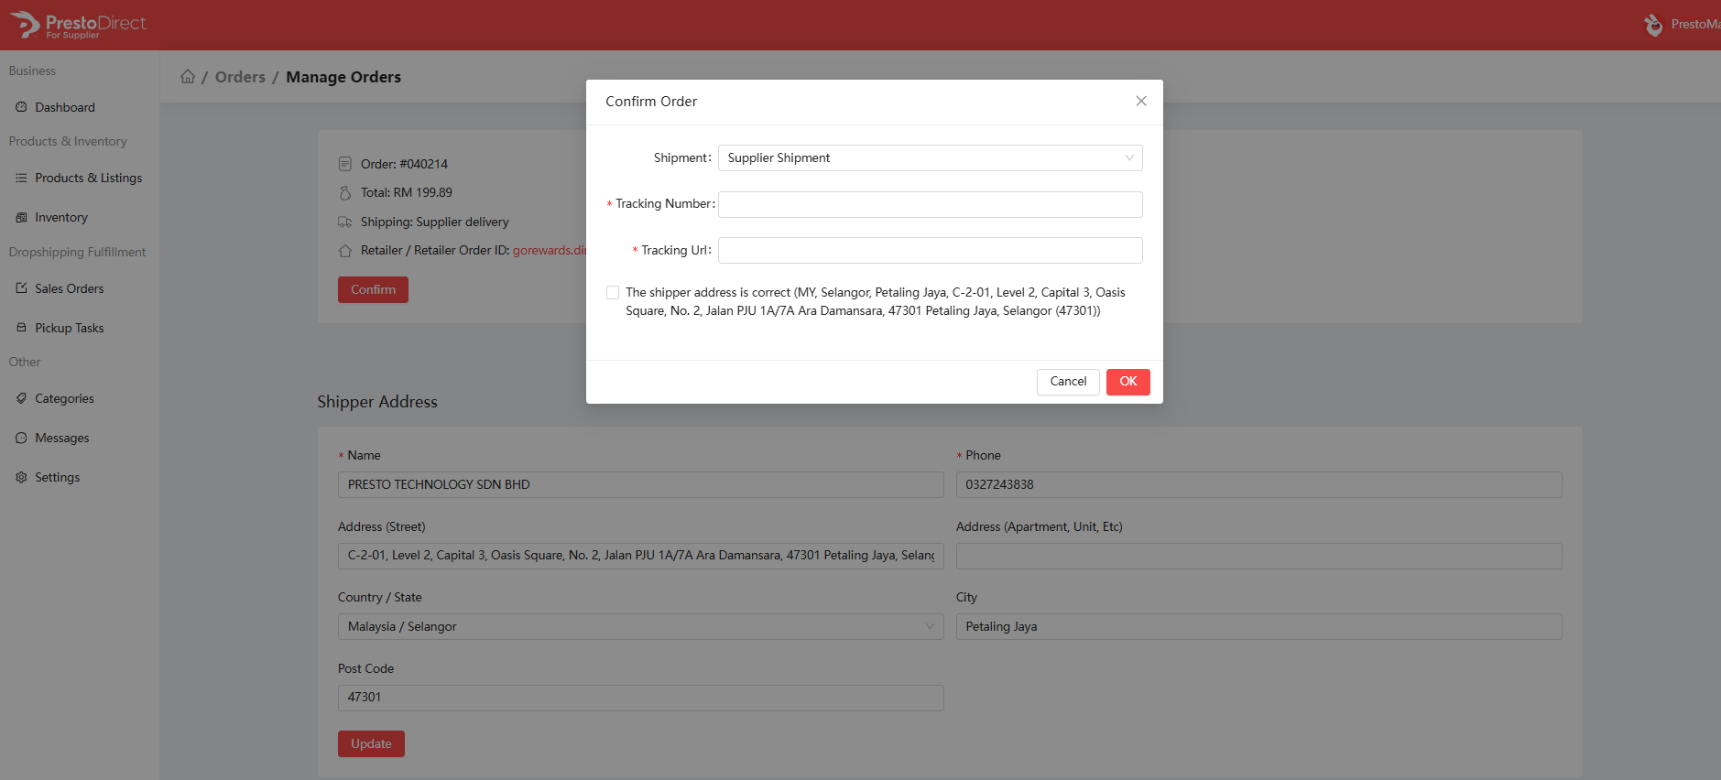
Supplier
Order Fulfilment Progress
Input tracking information and click ok button
Private & Confidential. All Rights Reserved © Presto

Slide 33
Supplier
Order Fulfilment Progress
Input tracking information and click ok button
Private & Confidential. All Rights Reserved © Presto

Slide 34
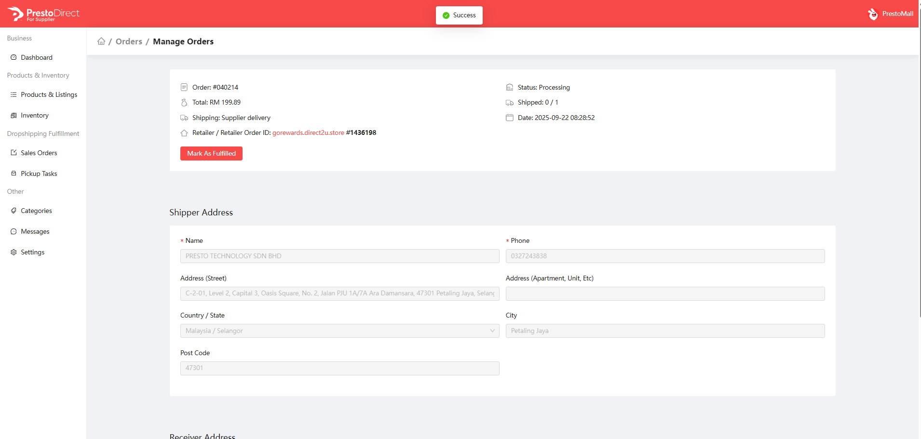
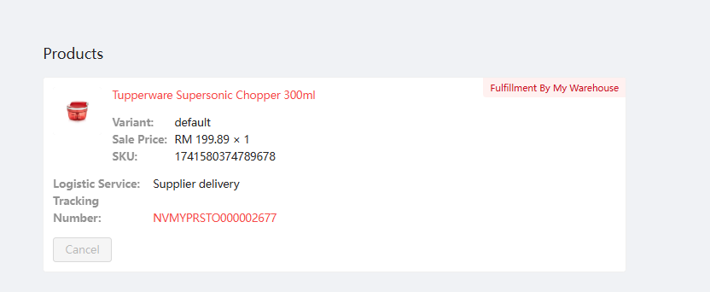
Supplier
Order Fulfilment Progress
Click this button if the parcel has ready to ship out. Or else the buyer would not able to see the parcel has shipped with tracking number
Tracking number has updated according the input and DO alert Presto if you have input wrong tracking number. Presto need amend the Tracking manually.
Private & Confidential. All Rights Reserved © Presto

Slide 35
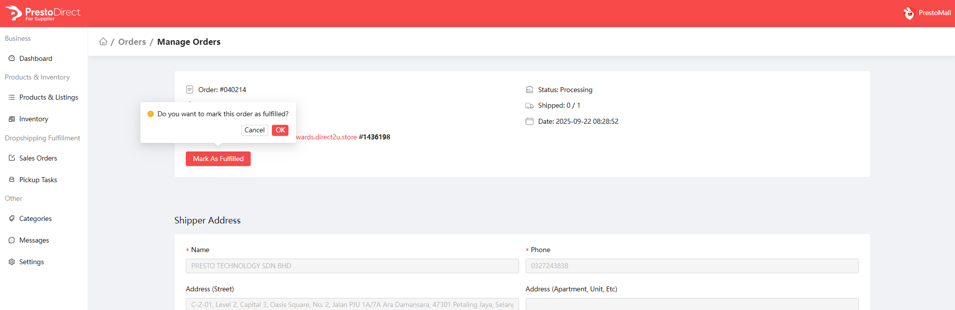
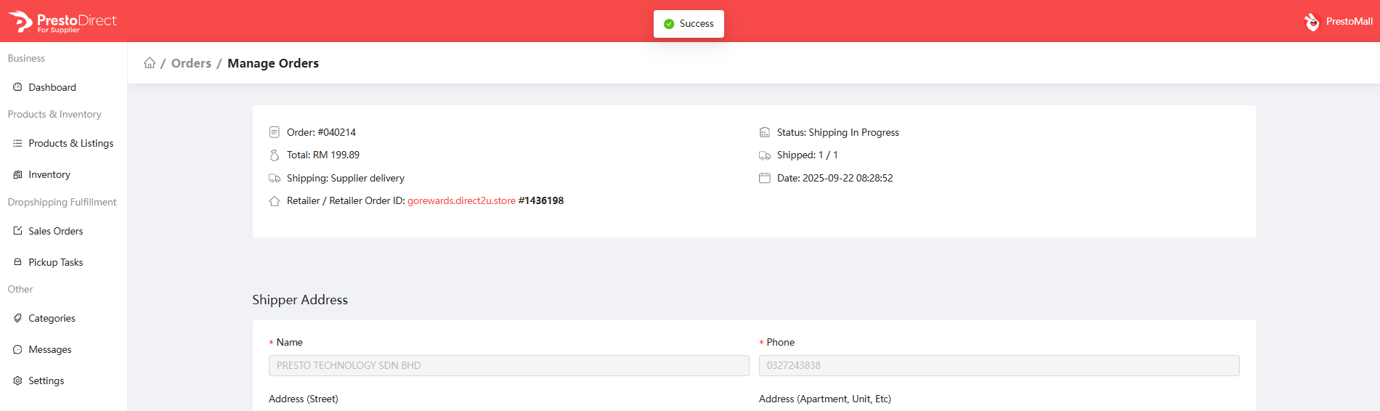
Supplier
Order Fulfilment Progress
Private & Confidential. All Rights Reserved © Presto

Slide 36
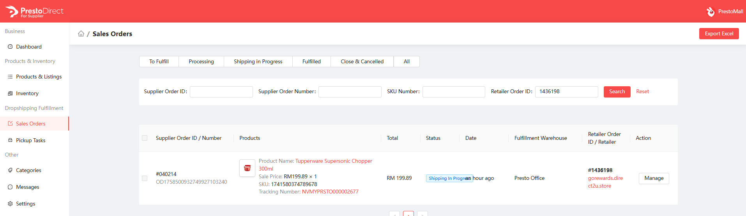
Supplier
Order Fulfilment Progress
Order status will update to shipping in Progress with tracking number and buyer will received the notification on the tracking number via email.
Private & Confidential. All Rights Reserved © Presto

Slide 37
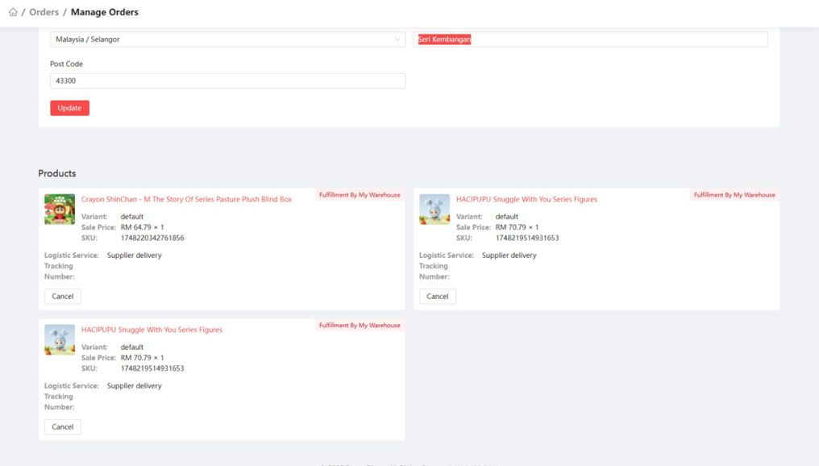
Supplier
Order Fulfilment Highlight
If you noticed duplicated SKU under same order, please do clarify with Presto Team to confirmed the purchase order and quantity before fulfil the order.
Private & Confidential. All Rights Reserved © Presto

Slide 38
Supplier
Purchase Workflow
Supplier Portal
Presto
Channel Store / Buyer
Propose with SKU with RRP and Channel Commission
Review New SKU
On Sale SKU
Buyer
Create SKU
Update Supplier
Setup point ratio in portal
Browse & Add to Cart
Receive Order
Source into Channel
Checkout & Payment
Pick & Pack
Accept Order
Order Created
Update Tracking No
Receive email for Tracking no
Receive Payment
Settlement 30 days
Order Completed
Received Parcel
Private & Confidential. All Rights Reserved © Presto

Slide 39
Supplier
Order Cancellation Workflow
Supplier Portal
Presto
Channel Store / Buyer
Propose with SKU with RRP and Channel Commision
Review New SKU
On Sale SKU
Buyer
Create SKU
Update Supplier
Setup point ratio in portal
Browse & Add to Cart
Receive Order
Source into Channel
Checkout & Payment
Accept Order
Order Created
Raise Cancellation request
Order will update as Closed
Customer Service
Update buyer
Closed
Proceed Cancellation
Agree and cancelled
Private & Confidential. All Rights Reserved © Presto

Slide 40
Supplier
SKU Listing Template
Supplier SKU Propose List - Master
https://foundermalaysia-my.sharepoint.com/:x:/g/personal/cathy_lee_prestoconnect_io/IQDPA2KDcyHpRp62KLSjBmqqAfi5hHeWxoNv-oanJioN_n0?e=bskYhe
Calculation formula :
RRP RM 100.00 – Channel Commission/ Point redemption 10% = RM 90.00
Cash Collection amount RM 90.00 – Presto Revenue Share 20% = RM 72.00
Supplier Settlement Amount 80% = RM 72.00
Channel Categories :
RRP : Presto Revenue share 20%
Channel Commission / Point redemption Rate : 5 – 20 %
EZ – Link :
Private & Confidential. All Rights Reserved © Presto

Slide 41

Notes:
Optional for use

